Slide 1


group company

Slide 2



group company
Numbers Only, Inc. is a technology driven IT Solutions Company providing innovative services, products, and resources. We partner with our clients to improve their business performance by providing innovative Information Technology solutions. Our approach is to deliver value for our clients through our unwavering focus on technology.
Founded
1997
Overview
^{Headquarters}
North Brunswick, NJ
^{Revenue FY 10}
$12 + Million
"To exceed the expectation of our customers"
By providing value to our customers with quality as the driving principle in products, services & relationships.
To provide integrated, cost-effective, state-of-the-art, quality solutions for utmost customer satisfaction.
VISION
&
MISSION
Employees
200+
North Brunswick, NJ
Irving, TX
Sunnyvale, CA
Hyderabad, India
Locations

Slide 3
Management - Team
group company
Nath Danturty - Chief Strategy Officer
Mr.Nath has more than several years of in the Information Technology and Online Gaming industries. Mr. Nath has held critical positions in technologies with top Australian Corporations such as IBM, Telstra, Best Bets, Lease Plan, AGL, IASBET, CANBET, SPORTS BET and OPENBET. Mr.Nath's core competencies are online Race betting, online Sports betting, Poker and Casino Games. He has spearheaded several path breaking and successful rollout of various Product launches for top Gaming companies in the UK and Australia. Mr. Nath has won several contribution and Team Recognition awards from Major Australian Corporates. Mr.Nath holds a Masters degree in Science from Andhra University, Visakhapatnam, India.
Raju VK - President
Mr. Raju VK founded "Numbers Only, Inc" in 1996 along with Mr. Hari Polavarapu. Mr.Raju has more than several years of experience in Information Technology industry and has been the brain behind designing complex enterprise systems using advanced Internet/Wireless technologies for "Numbers Only, Inc".
Mr. Raju VK has been responsible for overall technology and infrastructure strategy for the company. His strategic focus for the company has been in the products and advanced technology arena. He also currently serves as the President/CEO of AtPar, Inc., a spin-off of a Numbers Only research and development effort.
In the past Mr. Raju VK has held technical positions with several leading global IT services companies such as Tata Consulting Services, Foundation Software, and Analysts International. His consulting services have been leveraged by Fortune 500 companies such as M&M Mars, NY Times, Shoprite, and Allied Holdings. He also specializes in Healthcare Informatics and has provided consulting services for multiple healthcare organizations including Baptists Health, Blue Cross Blue Shield, Fletcher Allen, and Dartmouth Hitchcock Medical Center. Mr.Raju VK obtained his bachelor's degree in Mechanical Engineering from Osmania University, Hyderabad.

Slide 4
Why Fundoo Gaming?
group company
Extensive experience in Gaming Industry
Global and offshore delivery capabilities
Flexible engagement models
Proven methodology, processes and delivery models
Quality – manual and automated tools
Local empowerment and skills transfer
Providing highly responsive customer support
Deep Commitment to Global Behavior
Streamlining processes for greater operational efficiency
Unyielding focus on achieving client results
Strong Spirit of Collegiality
Extraordinary Commitment to People
Dedication to Client Collaboration & Teamwork
Fundamental Belief in Professional excellence

Slide 5
Service Offerings
group company
Application Development and Maintenance Services
Slot games development
Mobile Casino development
Gaming Services
Race betting and Sports betting projects
Mobile Application Development Services for Android
Mobile Application Development Services for iOs
Games Testing Services
Framework development

Slide 6

Application Development & Maintenance Services
group company
Development Services:
Maintenance Services:
Standalone Applications
Client Server Applications
3-Tier Applications
Applications Scalable to Multiple Platforms
Applications Using multiple Databases
Integration with other client systems
Maintain all kinds of Applications with
the Assurance of:
Decrease in Total Cost of Ownership (TCO)
Quick TAT (Turn Around Time)
Continuous Improvements in Quality of Services
Improve Applications Stability
24x7 Support

Slide 7
Mobile Apps Development & Gaming Services
group company
Business Applications
Social Networking Applications
Gaming Applications
Medical Applications
Race Betting Applications
Sports Betting Applications
Testing and support
Android/Tablet,
iPhone/iPad,Blackberry,
Windows,Symbain
Application Development
Flash Games
Java Games
Face book Games
MMO Games
Casino Games
Slot Games
Other Games
Web/Android/Tablet,
iPhone/iPad,Blackberry & PC, Gaming Services

Slide 8
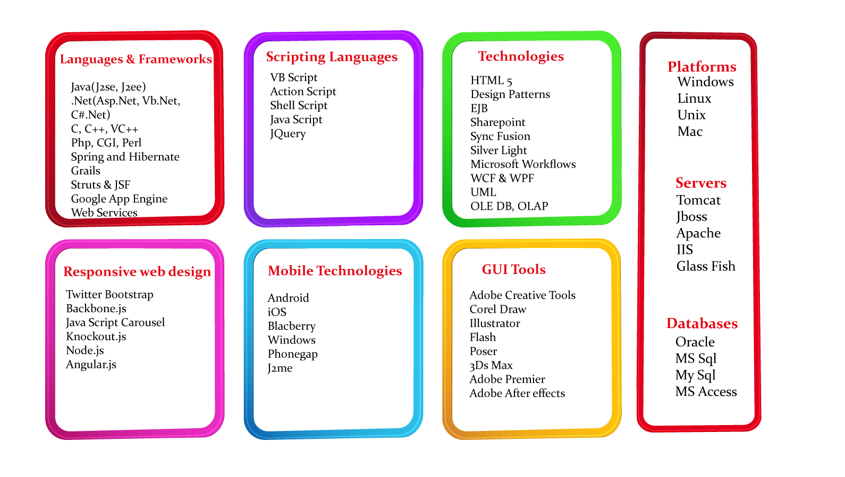
group company
Skill Sets

Slide 9
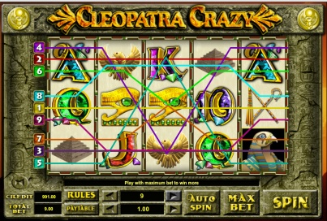
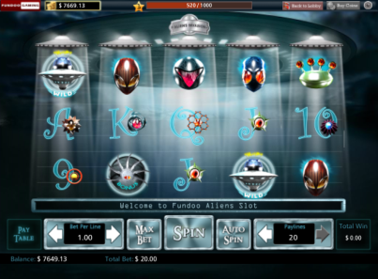
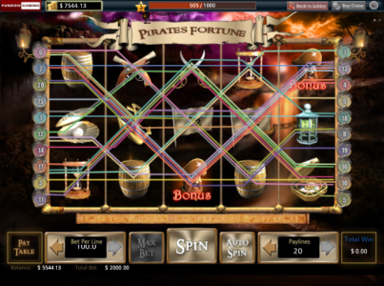
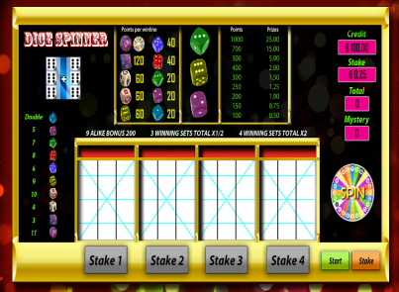
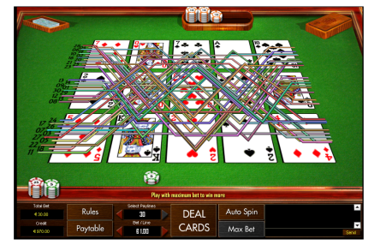
Gaming Domain Spectrum
group company
Flash Games
Slot Games
Face book Games
Other Games
Casino Games

Slide 10
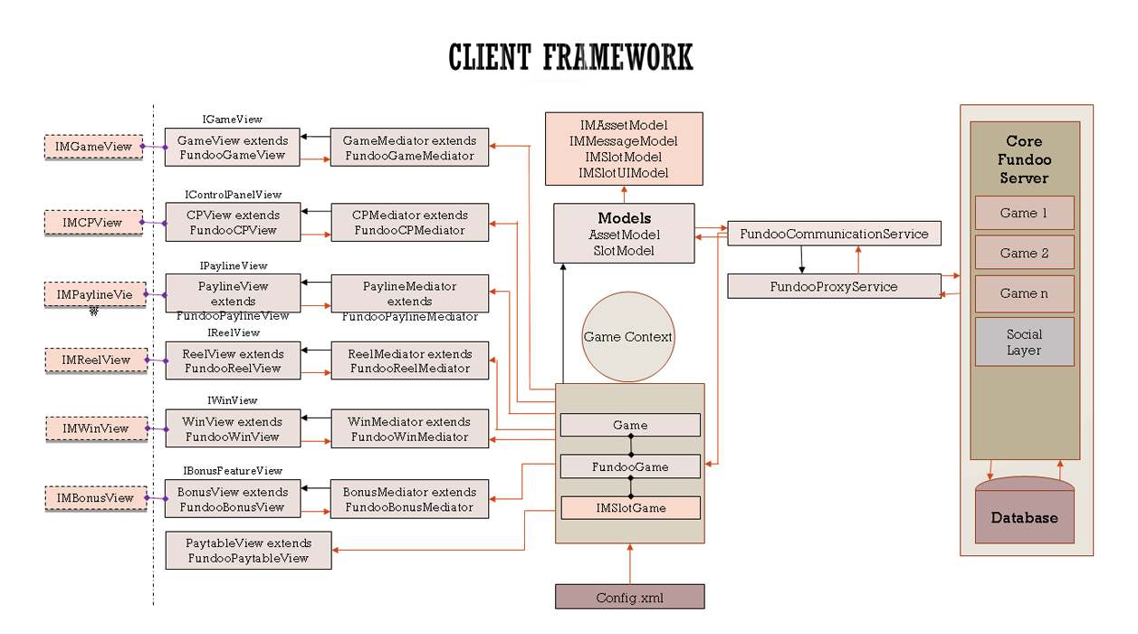
group company

Slide 11
group company
Framework Highlights
Supports easy customization
Multilingual
B2B
Built using latest GPU powered Flash
Much smoother performance
Take very less battery for mobiles
Capable of deploy product’s at the same time in the following platforms simultaneously
Face book, Google+, Yahoo games & Amazon
iOs & Android phones

Slide 12
Business Models
group company
Licensing :
The Casino games and slots frame work can be licensed to potential customers . The Games can also be
integrated to the clients backend.
Maintenance :
Gaming Applications (Client Games / Applications ) can be maintained by providing graphical
changes, integration, game math and performance.
Engagement Models :
Time and Material Based Pricing : This model to a large extent and recommend this approach when :
  The project requirements keep changing
  The relationship is long-term
  The customer has continuous work.
Fixed bid Pricing : This is recommend only when the project requirements are fixed and well defined.
Hybrid Pricing : Various models are possible
Simple model where it will be a Time and Material project until requirements specification is frozen and then based on an
estimate can be a Fixed Bid project.
Extended Team Pricing : A long-term contract to hire, build and then handover a full team to be used as an
extended team of the client to ultimately put up their own operations in

Slide 13

group company
Sample Clients

Slide 14
group company
THANK YOU

